Slide 1
AIM – HBO-ICT
Software
Design
Principles & PATTERNS – Factory method, adapter, facade, Program to an interface, Composition over inheritance, Law of Demeter en Dependency Inversion Principle

Slide 2
Classification of patterns
Behavioural patterns take care of effective communication and the assignment of responsibilities between objects.
Structural patterns explain how to assemble objects and classes into larger structures, while keeping these structures flexible and efficient.
Creational patterns provide object creation mechanisms that increase flexibility and reuse of existing code.

Slide 3
Behavioural
Strategy

Slide 4
Behavioural
state

Slide 5
Structural
adapter

Slide 6
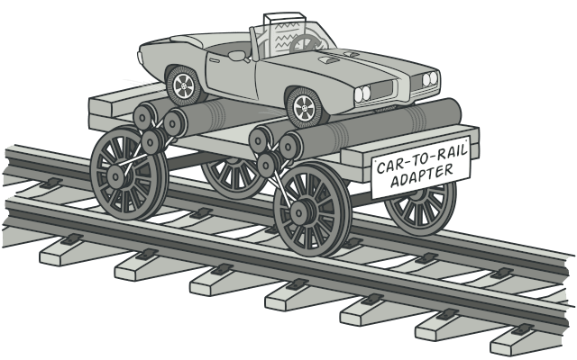

Adapter – intent
Demo
Problem
  A client class expects a certain interface for a method, but the providing component or class uses a different interface that is unchangeable.
Solution
  Add an extra class that serves as an adapter between the client and the providing component or class.
Intent
  Allow objects with incompatible interfaces to collaborate.

Slide 7
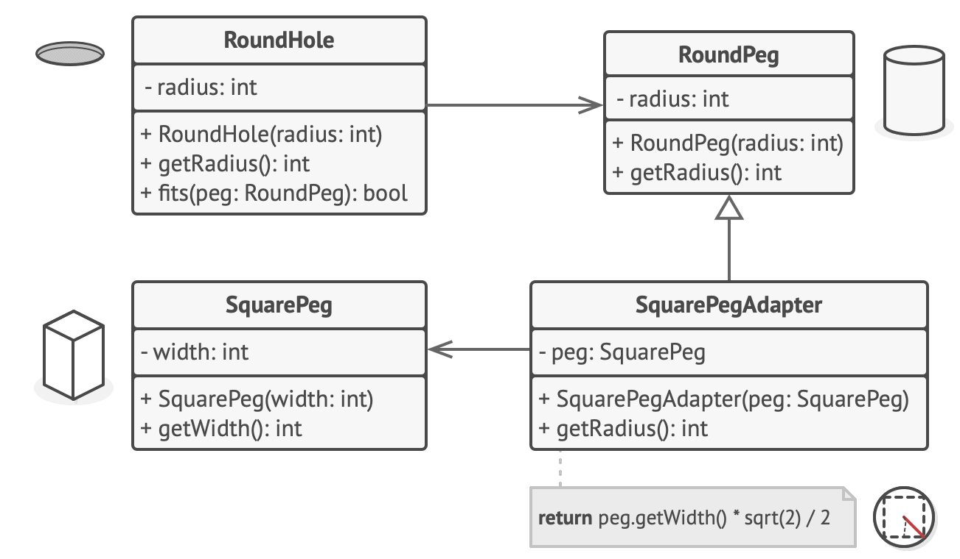
Adapter – applicability
Use the Adapter class when you want to use some existing class, but its interface isn’t compatible with the rest of your code.
Use the Adapter pattern when you want to reuse several existing subclasses that lack some common functionality that can’t be added to the superclass.

Slide 8
Adapter – pros and cons
Pro
Con
Single Responsibility Principle. You can separate the interface or data conversion code from the primary business logic of the program.
Open/Closed Principle. You can introduce new types of adapters into the program without breaking the existing client code, as long as they work with the adapters through the client interface.
Adheres to Composition over Inheritance and Program to an Interface
The overall complexity of the code increases because you need to introduce a set of new interfaces and classes. Sometimes it’s simpler just to change the service class so that it matches the rest of your code.

Slide 9
Structural
FACADE

Slide 10
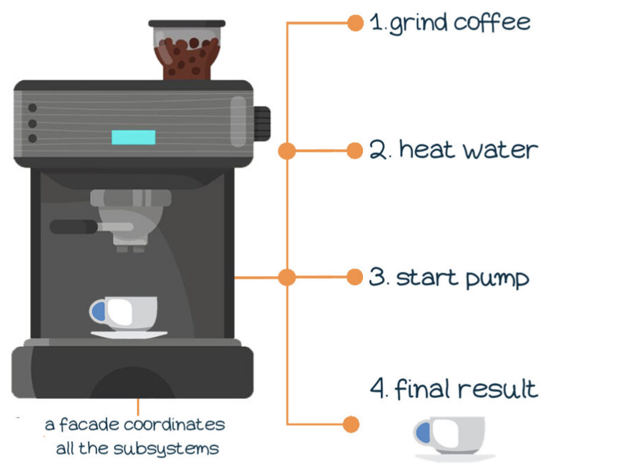
Facade – intent
Demo
Problem
  A subsystem is hard to use due to a complex interface.
  A class has is tightly coupled to a subsystem.
Solution
  Define a Facade object that implements a simple interface in terms of (by delegating to) the interfaces in the subsystem and may perform additional functionality before/after forwarding a request.
Intent
  Provide a simplified interface to a library, a framework, or any other complex set of classes.

Slide 11
Facade – applicability
Use the Facade pattern when you need to have a limited but straightforward interface to a complex subsystem.
Use the Facade when you want to structure a subsystem into layers.

Slide 12
Facade – pros and cons
Pro
Con
You can isolate your code from the complexity of a subsystem.
Adheres to Composition over Inheritance and Law of Demeter
A facade can become a god object coupled to all classes of an app.

Slide 13
Creational
Factory method

Slide 14
Factory method – intent
Demo
Problem
  When a system is designed to work with a particular set of classes, and you want to allow for new classes to be introduced without modifying existing code
  Client code is highly coupled to the specific classes it instantiates
Solution
  Introduce one or more class that have the responsibility to create new objects with a shared interface
Intent
  Provide an interface for creating objects in a superclass, but allow subclasses to alter the type of objects that will be created

Slide 15
FACTORY method – applicability
Use the Factory Method when you don’t know beforehand the exact types and dependencies of the objects your code should work with.
Use the Factory Method when you want to provide users of your library or framework with a way to extend its internal components.
Use the Factory Method when you want to save system resources by reusing existing objects instead of rebuilding them each time.

Slide 16
Factory method – pros and cons
Pros
Cons
You avoid tight coupling between the creator and the concrete products.
Single Responsibility Principle. You can move the product creation code into one place in the program, making the code easier to support.
Open/Closed Principle. You can introduce new types of products into the program without breaking existing client code.
The code may become more complicated since you need to introduce a lot of new subclasses to implement the pattern. The best case scenario is when you’re introducing the pattern into an existing hierarchy of creator classes

Slide 17
Program to an Interface
Ontwerp software door te programmeren tegen interfaces, niet tegen concrete implementaties, zodat code flexibeler en uitbreidbaarder is.

Slide 18
Composition over Inheritance
Gebruik samenstelling (composition) in plaats van overerving om flexibel gedrag toe te voegen aan klassen.

Slide 19
Law of Demeter
Een object mag alleen methoden aanroepen van directe 'vrienden' en niet van indirecte componenten ('talk to friends, not strangers').

Slide 20
Dependency Inversion Principle
Hoog-niveau modules mogen niet afhankelijk zijn van laag-niveau modules; beide moeten afhankelijk zijn van abstracties.

